Slide 1



Slide 2



 | Slope Bins 4 | Smear Count 25
Block number | Alpha w/ Henderson Hasselbalch | Chi Chi_max = 2.2
[0 50] | 0.040012 | 1.160000
[50 75] | -0.278451 | 0.720000
[75 125] | -0.519707 | 0.608000
[125 156] | -0.154453 | 0.529032

Slide 3


 | Slope Bins 4 | Smear Count 31
Block number | Alpha w/ Henderson Hasselbalch | Chi Chi_max = 2.2
[0 31] | 0.001103 | 0.922581
[31 62] | -0.386873 | 0.703226
[62 93] | -0.290146 | 0.967742
[93 496] | 0.037164 | 1.098759
[496 527] | -0.064533 | 0.819355
[527 620] | 0.010682 | 0.756989
[620 647] | -0.103326 | 0.696296

Slide 4
Binary results

Slide 5







For i as L and H:
Pure height profiles
Mixed height profiles
Current L library
Current H library
Skip; marginal increase in vol prob not enough
Move onto chi3.0; larger NFL vol library

Slide 6





All plotting wrong L pure; look only at purp
NFL
NFH
H volume too low to neutralize L (v = 31 nm3/c)

Slide 7







H volume v = 60 nm3/c

Slide 8







H volume too low to neutralize L

Slide 9






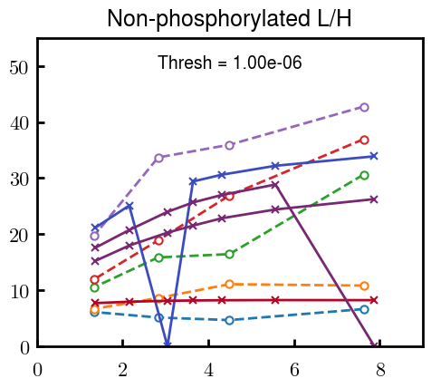


Slide 10
L/H Fitting

Slide 11
Try b change, v same as H (0.15)

Slide 12


Continuation from prev params

Slide 13








Try similar params to H
5.6
11.2
16.8
28
56
7.5
11.25
18.75

Slide 14


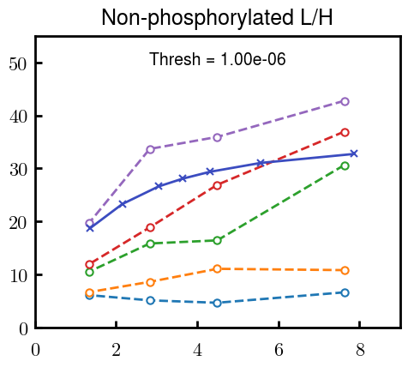
Try similar params to H, b change
15.6
23.4
31.2

Slide 15







v2.7 and some fine
b1.50 v2.7 c3.2
b1.75 v2.7 c3.2
b1.75 v2.5 c3.2
b1.75 v2.5 c3.0
b2.0 v2.7 c3.2
b2.25 v2.7 c3.2
b2.50 v2.7 c3.2
Phi too small to decrease v0

Slide 16










b2.0 v10.0 c3.0
b2.0 v8.0 c3.0
b2.0 v6.0 c3.0
b2.0 v4.0 c3.0
b2.0 v2.0 c3.0
Phi limit
b1.8 v10.0 c3.0
b1.8 v8.0 c3.0
b1.8 v6.0 c3.0
b1.8 v3.0 c3.0
b1.8 v2.0 c3.0
Phi limit

Slide 17





b1.6 v10.0 c3.0
b1.6 v8.0 c3.0
b1.6 v6.0 c3.0
b1.6 v2.0 c3.0
b1.6 v1.5 c3.0
Phi limit

Slide 18


Response to stimuli given composition
Same data
Effect of composition given environment

Slide 19


NFL, pH 7.44, phos 1.5e (locs from LCMS)
Non-phos NFL
Block number | Alpha w/ Henderson Hasselbalch | Chi Chi_max = 3.2
[0 50] | 0.040012 | 1.540000
[50 75] | -0.278451 | 0.960000
[75 125] | -0.519707 | 0.868000
[125 156] | -0.154453 | 0.690323
 | Slope Bins 4 | Smear Count 25
Block number | Alpha w/ Henderson Hasselbalch | Chi Chi_max = 3.2
[0 50] | -0.019988 | 1.540000
[50 75] | -0.278451 | 0.960000
[75 125] | -0.519707 | 0.868000
[125 156] | -0.154453 | 0.690323

Slide 20


NFH, pH 7.44, phos 1.5e (locs from LCMS)
 | Slope Bins 4 | Smear Count 36
Block number | Alpha w/ Henderson Hasselbalch | Chi Chi_max = 3.2 | Chi Chi_max = 3.0
[0 36] | 0.000945 | 1.266667 | 1.20000
[36 72] | -0.527455 | 0.900000 | 0.85000
[72 324] | -0.208376 | 1.729365 | 1.628571
[324 396] | -0.111195 | 1.416667 | 1.333333
[396 432] | -0.152824 | 1.344444 | 1.266667
[432 647] | -0.033955 | 1.077209 | 1.015814

Slide 21

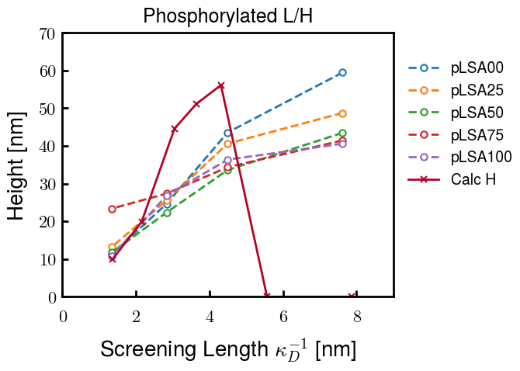
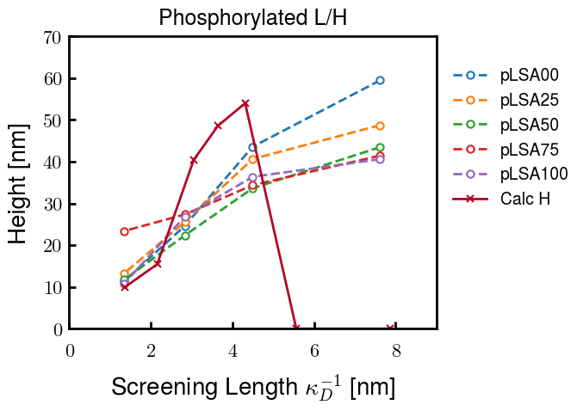
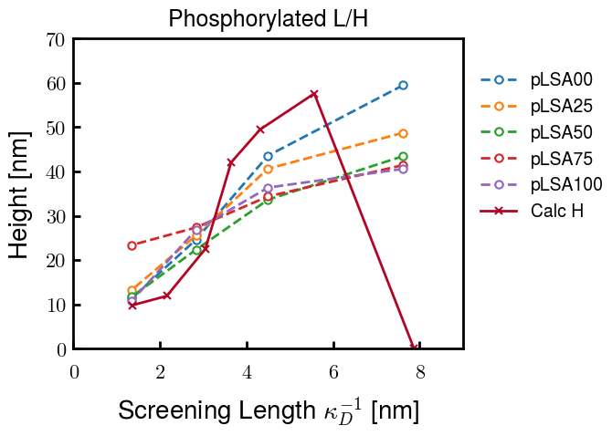
Instead of fitting b/v, could just change value of charge on phos. Try both and see if makes difference for mixture

Slide 22









b2.0 v2.7 c3.2
b3.0 v3.5 c3.5
b3.0 v7.0 c3.5
b3.0 v7.0 c3.0
Phi too small
Phi too small to decrease v0
b4.0 v12.0 c3.0
b5.0 v20.0 c3.0
b5.0 v20.0 c4.0
b5.0 v5.0 c3.0
b5.0 v10.0 c3.0
Phi too small to decrease v0

Slide 23





v20
b5.0 v20.0 c3.0
b4.5 v20.0 c3.0
b4.0 v20.0 c3.0
b3.5 v20.0 c3.0
v10
b5.0 v10.0 c3.0
b4.0 v10.0 c3.0
b3.0 v10.0 c3.0
b2.0 v10.0 c3.0

Slide 24




b2.00 v2.70 c3.20
b2.00 v2.75 c3.20

Slide 25
NFH fitting (from NFL best fit)

Slide 26








b1.00, v0.50, c3.2
b2.00, v4.00, c3.2, th2.5e-02
b1.00, v2.00, c3.2
b1.00, v1.00, c3.2

Slide 27
Mixture

Slide 28



Slide 29


b = 0.75

Slide 30





Slide 31
b = 1.0

Slide 32





Slide 33
b = 1.25

Slide 34




Chi 2.6
Bad vol frac

Slide 35








b25v0
b25v1
b25v2
b25v3

Slide 36




Chi 2.8
Bad vol frac

Slide 37





Slide 38
b = 1.50

Slide 39






Chi 2.8
Bad vol frac

Slide 40





Slide 41

b = 2.00
v4 = 0.25*b^3

Slide 42


Bad vol frac

Slide 43



Slide 44
Fine tune

Slide 45



b1.25, v1.95, c3.0
b1.50, v3.38, c3.0
b2.00, v4.00, c3.0
Norm seems to capture kinked behavior

Slide 46




Slide 47



b1.25, v1.95, c3.2
b1.50, v3.38, c3.2
b2.00, v4.00, c3.2

Slide 48




Slide 49


b1.25
b1.50
b2.00
c2.8
c3.0
c3.2

